Slide 1
HOUSE PRICE PREDICTION PROJECT

Slide 2
OUTLINE
Explanatory Data Analysis
Data Cleaning & Imputation
Modelling & Prediction
Conclusion

Slide 3
EXPLANATORY DATA ANALYSIS
Categorical Data Analysis
Numerical Data Analysis

Slide 4
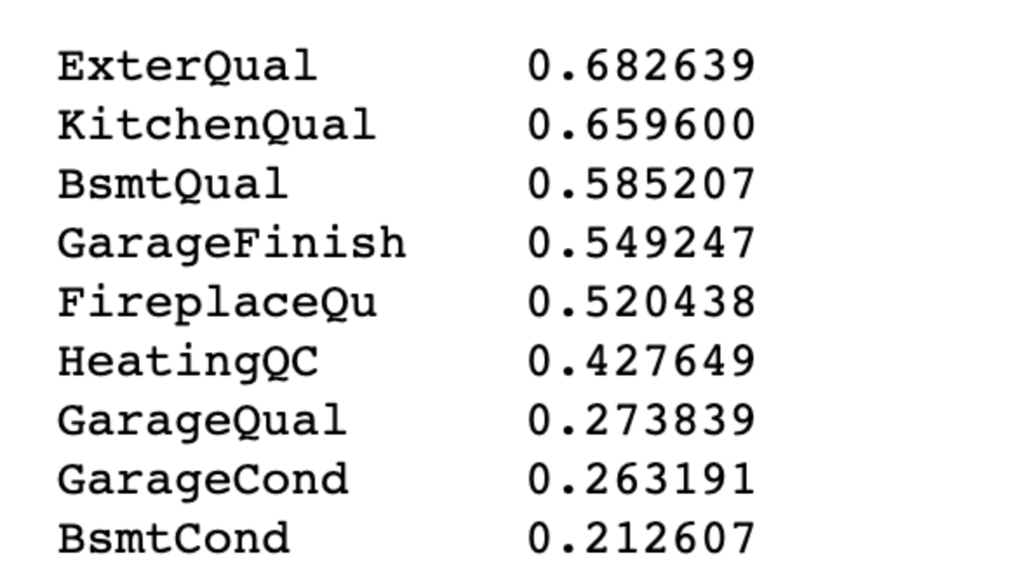
CATEGORICAL DATA ANALYSIS

Slide 5
CATEGORICAL DATA ANALYSIS

Slide 6
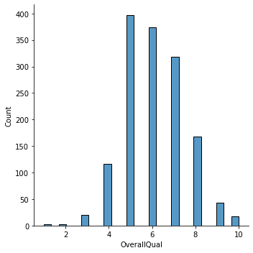
CATEGORICAL DATA ANALYSIS

Slide 7
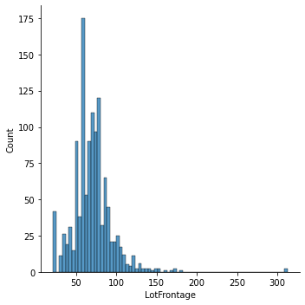
CATEGORICAL DATA ANALYSIS

Slide 8
NUMERICAL DATA ANALYSIS
Information that is measurable
Data represented as numbers and not words or text

Slide 9
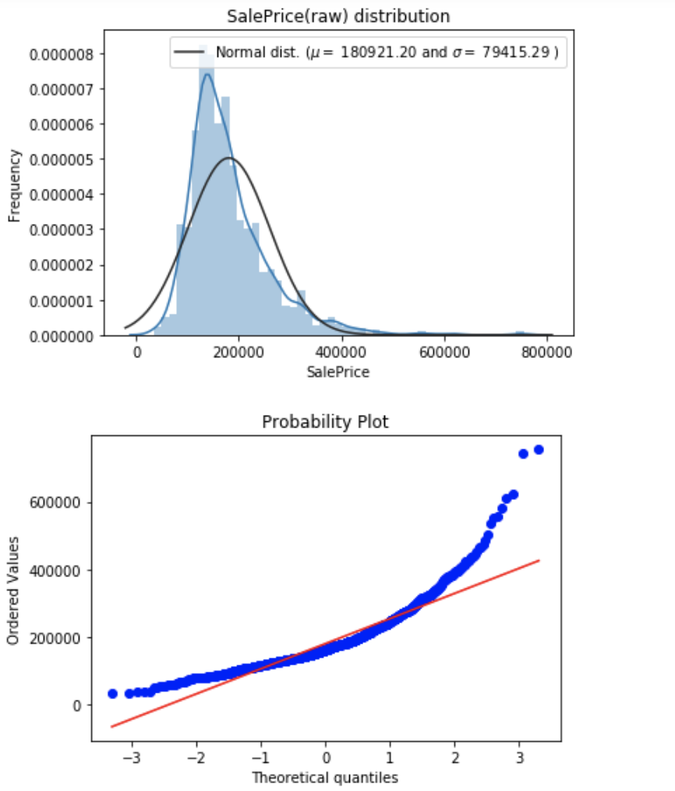
NUMERICAL DATA ANALYSIS

Slide 10
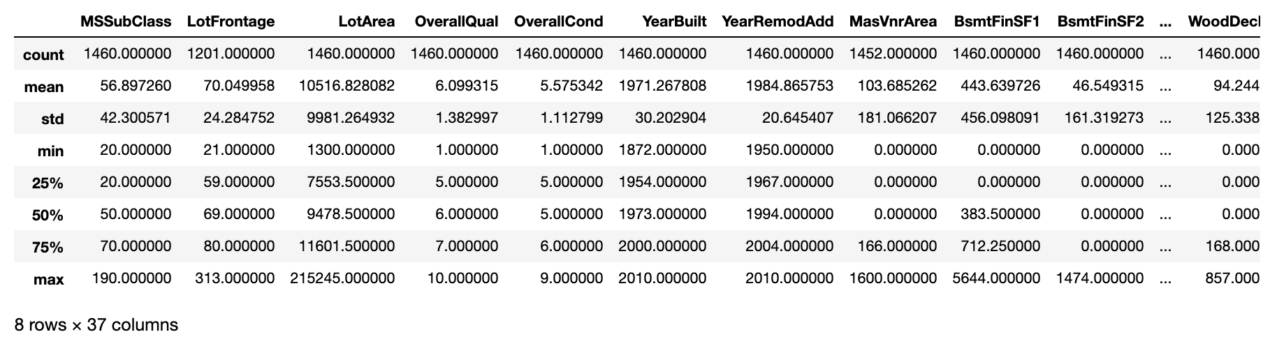
NUMERICAL DATA ANALYSIS

Slide 11
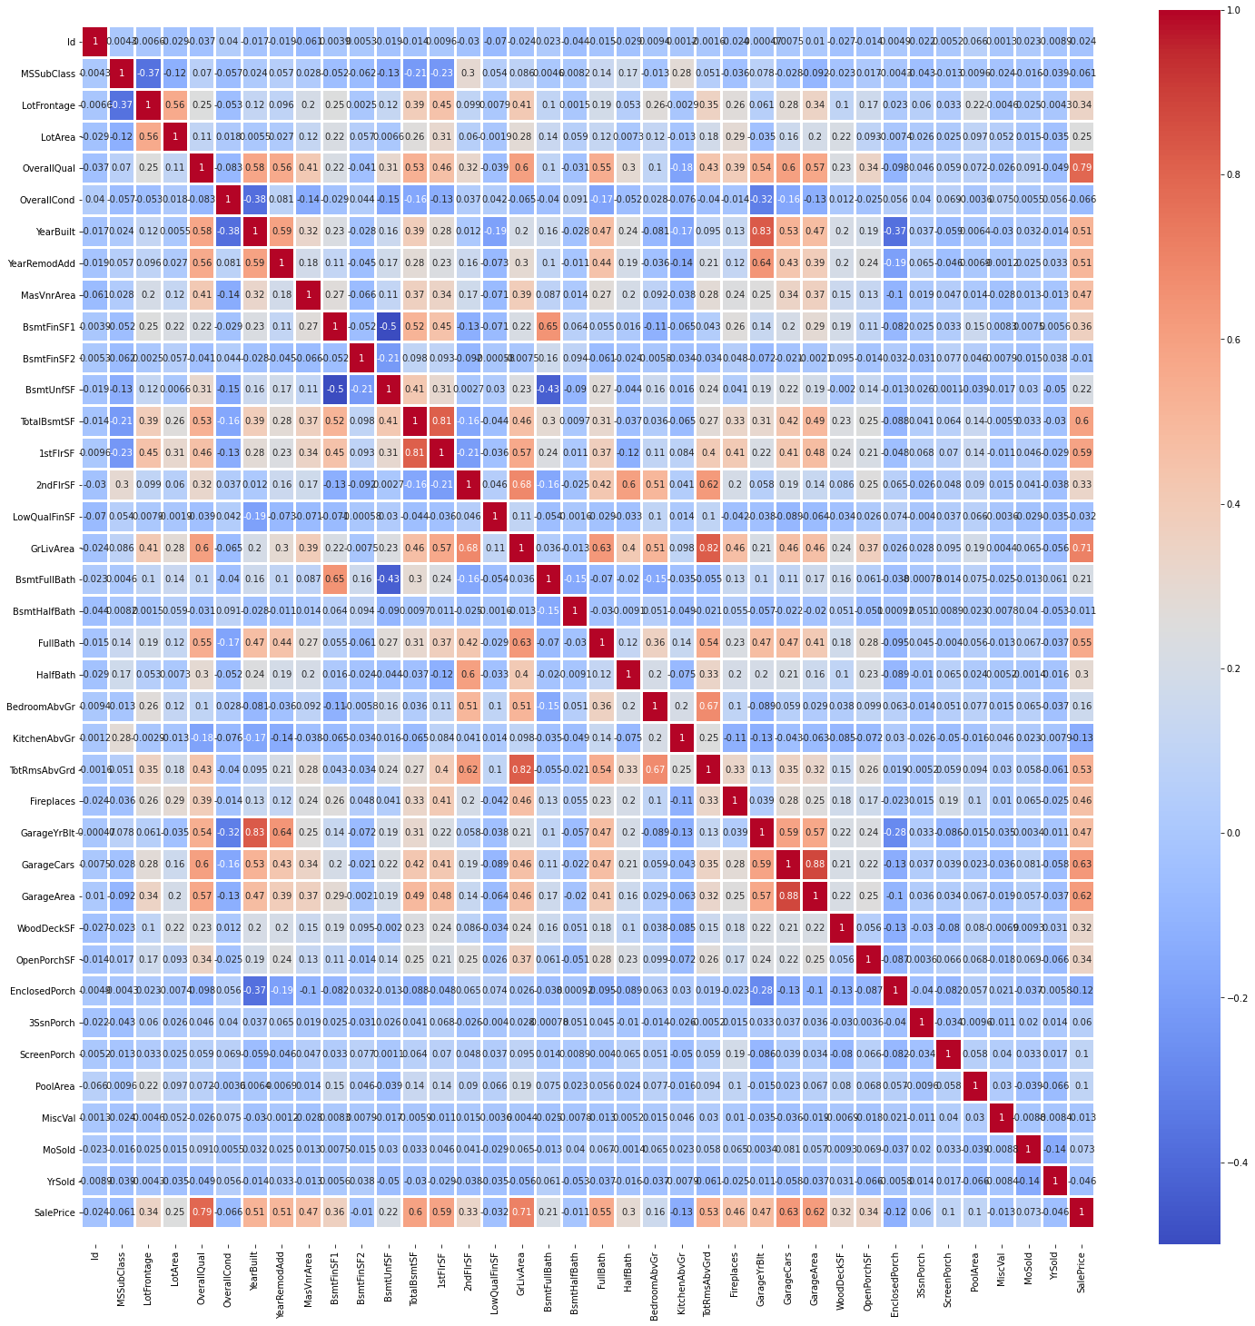
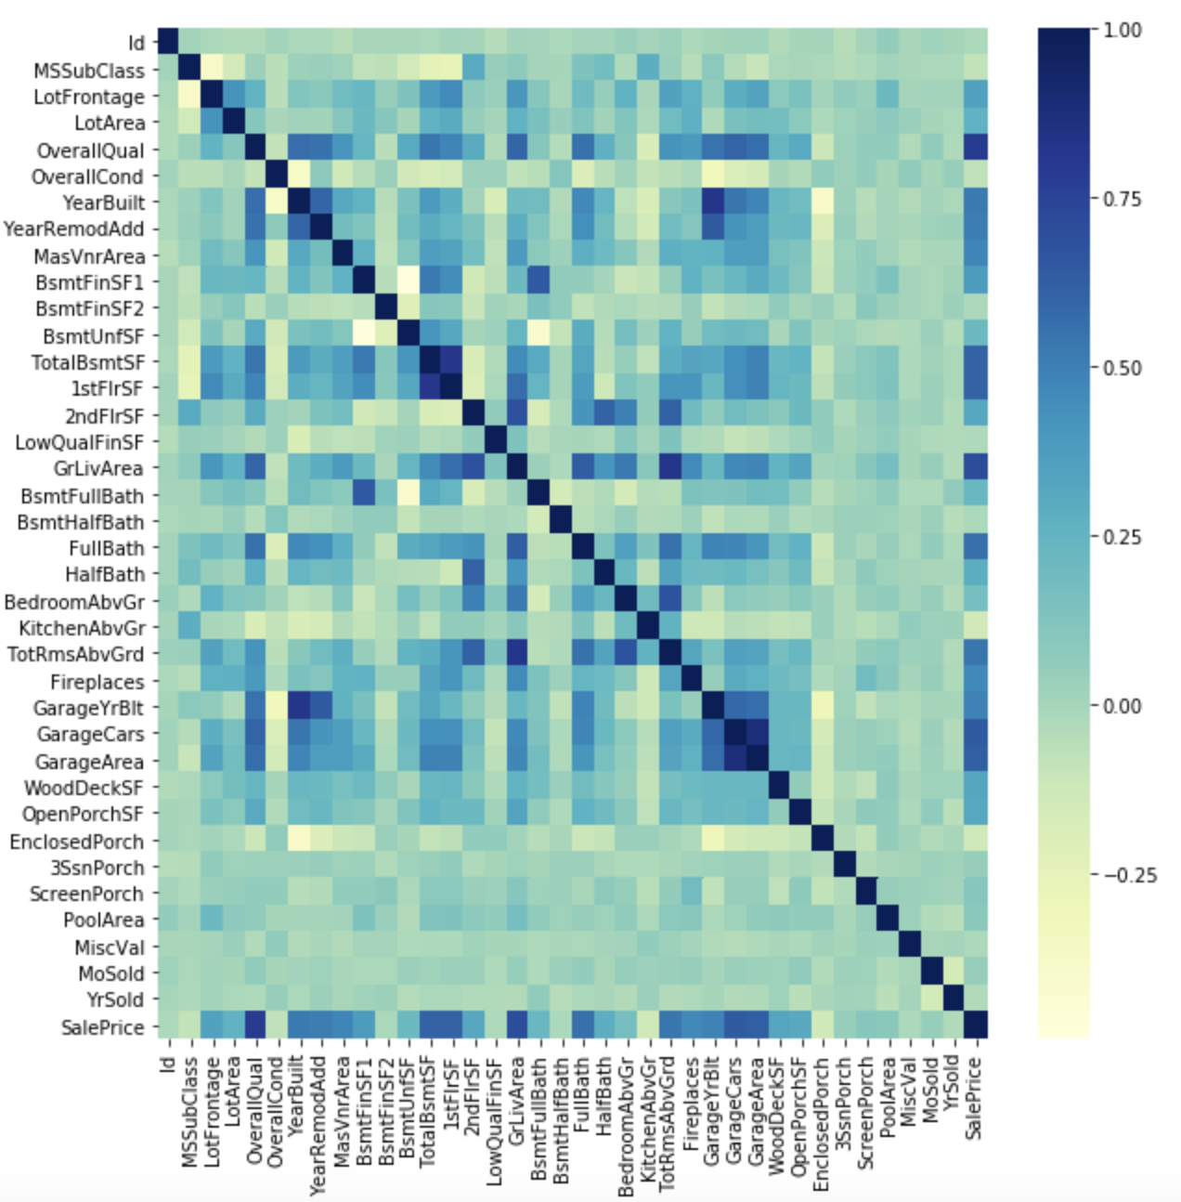
NUMERIC CORRELATION MATRIX

Slide 12
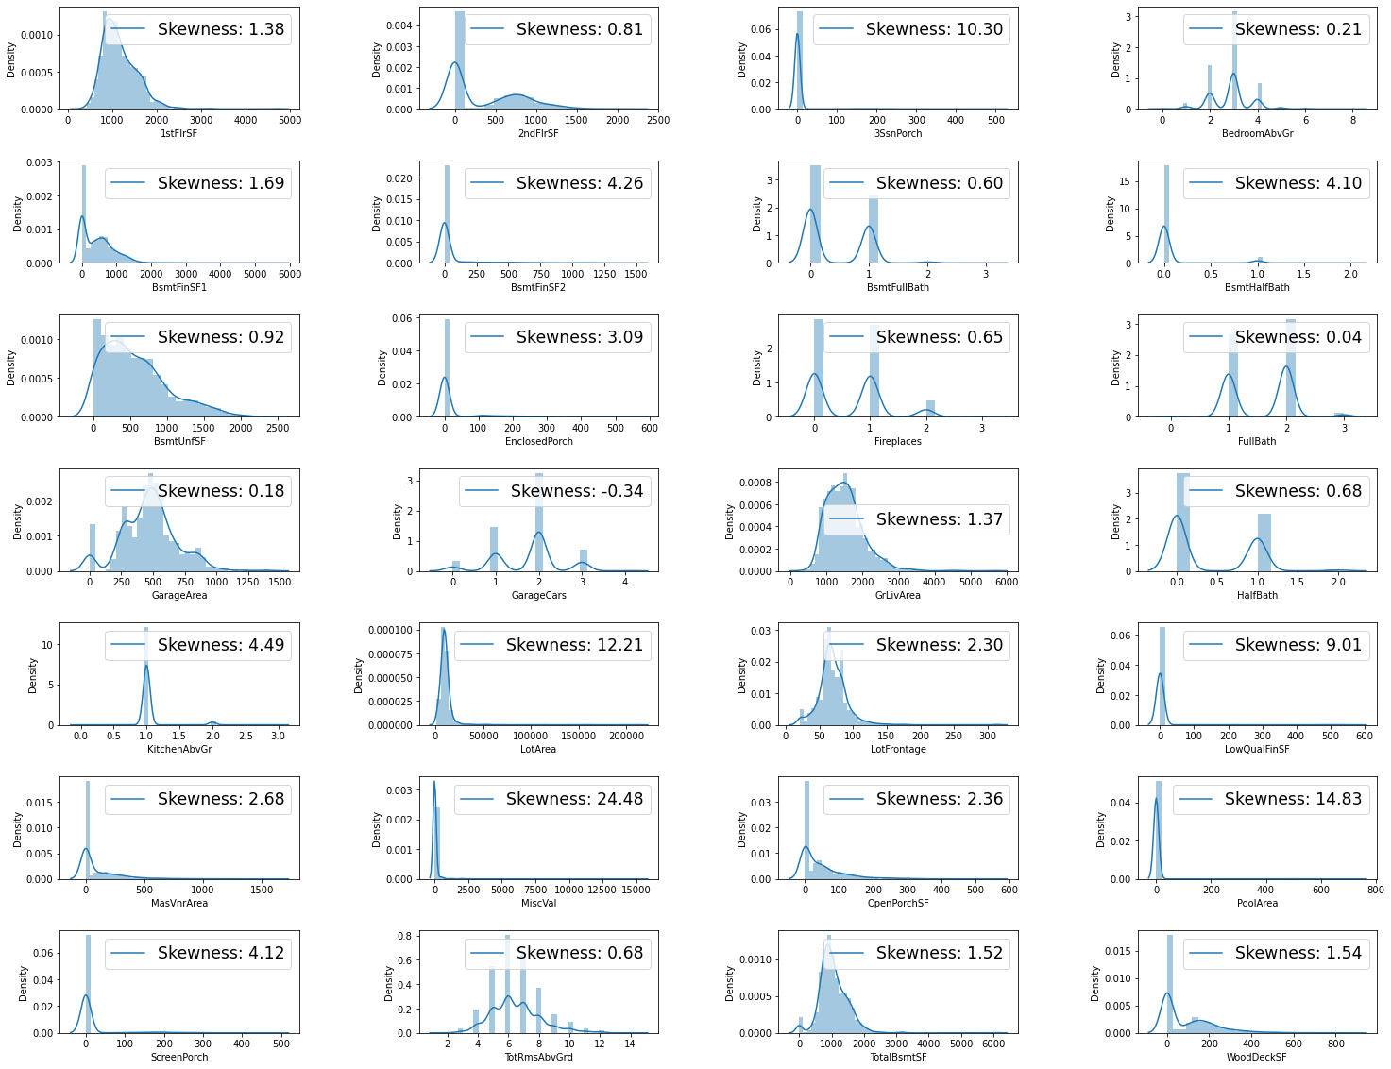
NUMERICAL DATA ANALYSIS

Slide 13
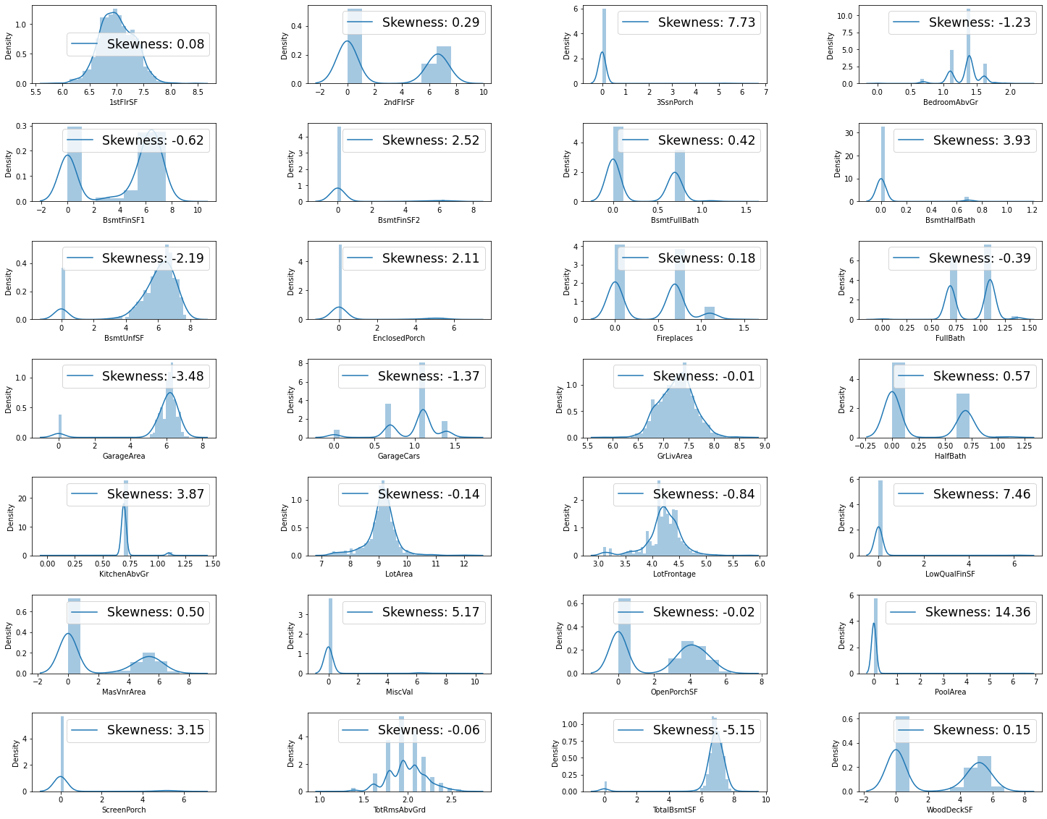
NUMERICAL DATA ANALYSIS

Slide 14
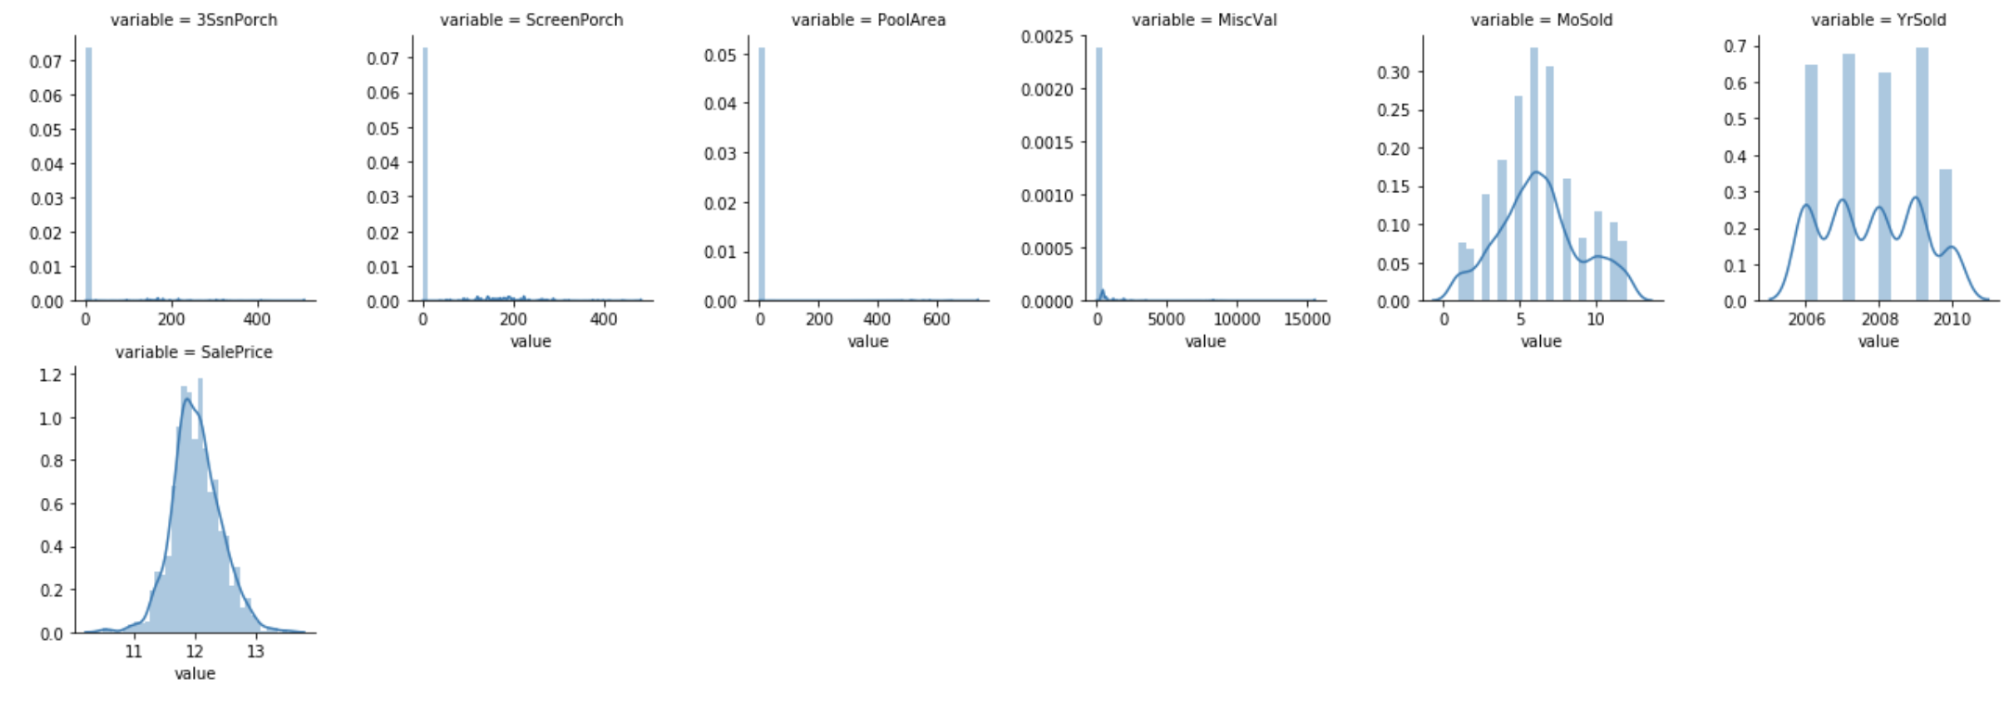
NUMERICAL DATA ANALYSIS

Slide 15
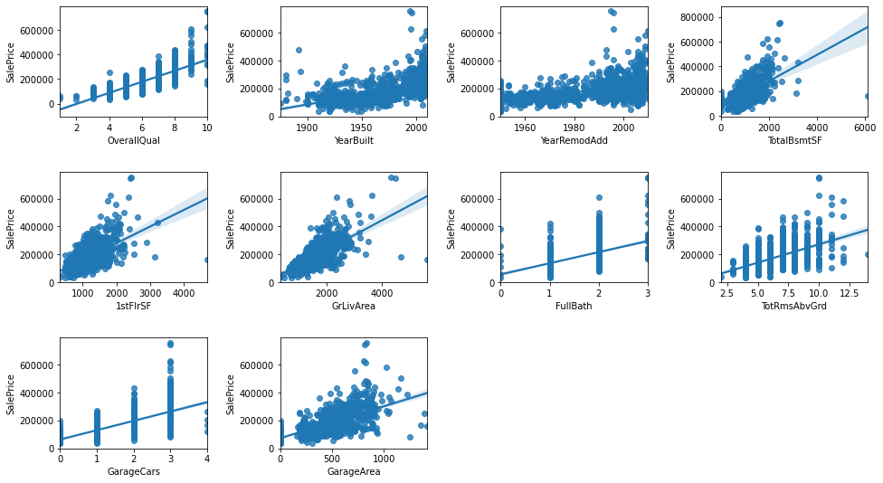
NUMERICAL DATA ANALYSIS
.

Slide 16
DATA CLEANING & IMPUTATION
Checking Missing Value
Imputation

Slide 17
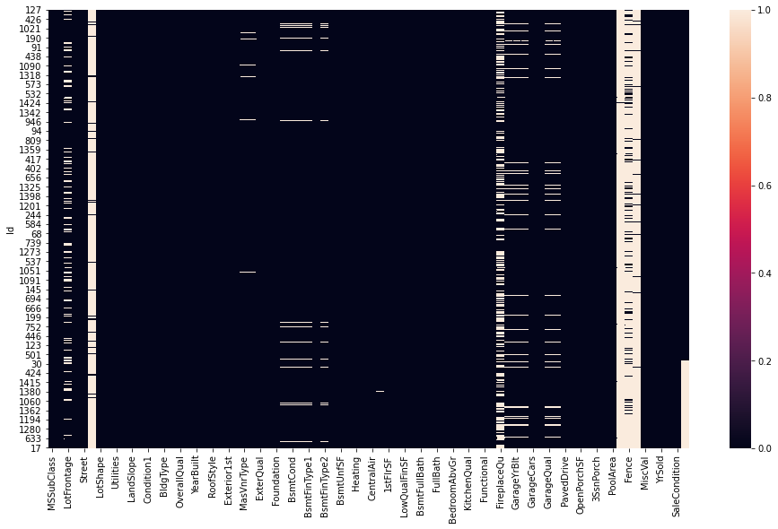
ANALYZE MISSING VALUES
PoolQC | 99.657417
MiscFeature | 96.402878
Alley | 93.216855
Fence | 80.438506
FireplaceQu | 48.646797
LotFrontage | 16.649538
GarageQual | 5.447071
GarageCond | 5.447071
GarageFinish | 5.447071
GarageYrBlt | 5.447071
GarageType | 5.378554
BsmtExposure | 2.809181
BsmtCond | 2.809181
BsmtQual | 2.774923
BsmtFinType2 | 2.740665
BsmtFinType1 | 2.706406

Slide 18

ARE DATA REALY MISSING ?
PoolQC
MiscFeature
Alley
Fence
FireplaceQu
GarageQual
GarageCond
GarageFinish
GarageType
NA = Not exist, Refers to “data_description.txt”

Slide 19

IMPUTATION METHODS
Median Imputation For ‘LotFrontage’ due to outlier
Mode Imputation For Categorical Variables
Zero Imputation Logical reasoning

Slide 20
Model Analysis
MODELLING & PREDICTION
Multiple Linear Regression
Gradient Boosting
Random Forests

Slide 21
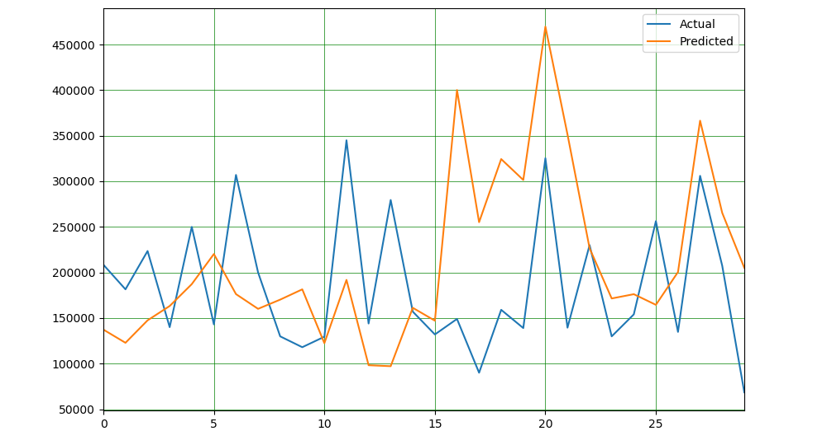
LINE GRAPH SHOWING TRAINING DATA PREDICTION (HEAD)

Slide 22
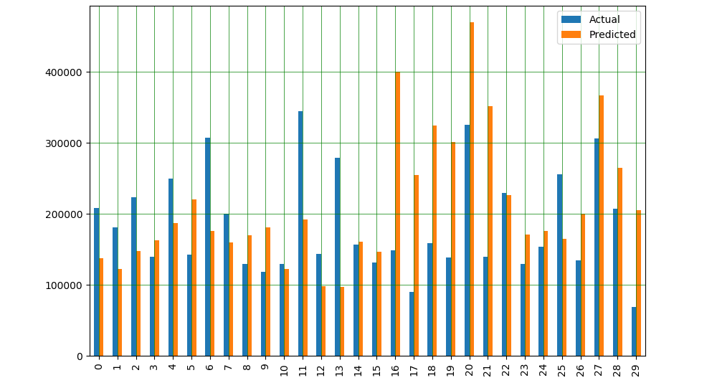
BAR GRAPH SHOWING TRAINING DATA PREDICTION (HEAD)

Slide 23
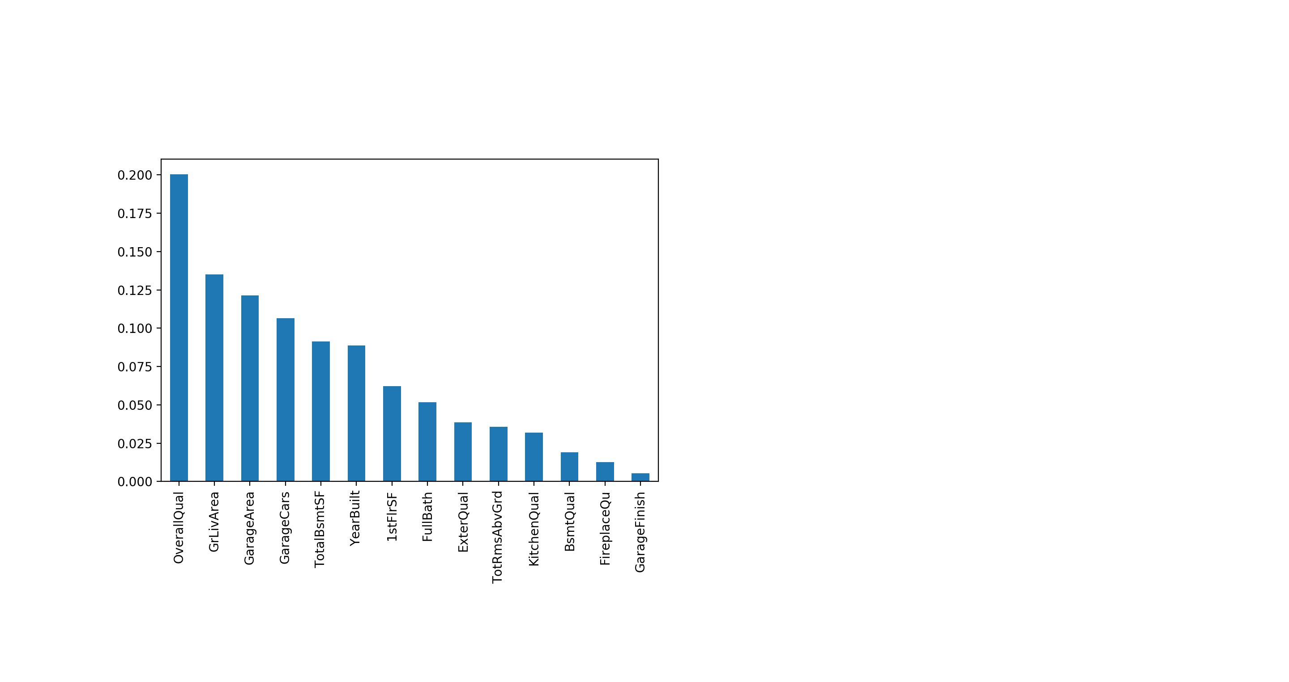
FEATURE IMPORTANCE

Slide 24
MODELS TESTED
Model | Train Score(R2)
Linear Regression | 0.943263
Support Vector Machine | 0.916639
Random Forest | 0.997823
Decision Tree Regressor | 0.995930

Slide 25
SELECTED MODEL METRICS
SVM Was Selected For Prediction Among All the Reviewed Models

Slide 26
CONCLUSION
Feature selection can be improved upon as the remaining features were still not quite optimal.
Future work to improve prediction is to use ensemble methods to combine several methods to achieve a better prediction model.
There is room for improvement of the model with regard to the prediction technique used.
Notes:
Ensemble methods are techniques that create multiple models and then combine them to produce improved results. Ensemble methods usually produces more accurate solutions than a single model would.

Slide 27
That’s All For Now, Thank You.

